Slide 1
DETECTION OF PHISHING WEBSITES USING MACHINE LEARNING
BY
Shreya, Yogesh, Nitish & Abhishek
(7th semester Project)
SUPERVISED BY Prof. Pragya Choudhary

Slide 2
PRESENTATION OUTLINE
01
02
03
INTRODUCTION
STATEMENT OF PROBLEM
AIM AND OBJECTIVES

Slide 3
PRESENTATION OUTLINE
04
05
06
SCOPE OF STUDY
SIGNIFICANCE OF STUDY
METHODOLOGY

Slide 4
PRESENTATION OUTLINE
07
08
09
LITERATURE REVIEW
BENEFIT OF PROPOSED SYSTEM
EXISTING AND PROPOSED SYSTEM

Slide 5
PRESENTATION OUTLINE
10
11
12
CONCLUSION
SYSTEM DESIGN (Diagram)
IMPLEMENTATION & CONTRIBUTION TO KNOWLEDGE
REFERENCE

Slide 6

INTRODUCTION
The Internet global connectivity is regarded as a crossroads where users can meet and share information. This is the primary reason phishers choose this method of data exchange as a point of contact to conduct widespread phishing attacks by infecting computers with spyware that directs people to bogus websites.
Phishing attack is one of the most dangerous threats to online accounts and data because these attacks pose as a trustworthy firm or person, and they employ social engineering techniques to make victims more likely to fall for the scam.
(Source: Designed by Freepik, n.d.)

Slide 7

STATEMENT OF PROBLEM
Phishing attacks have gotten increasingly complex, it is very difficult for an average person to determine if an email message link or website is legitimate. Cyber-attacks by criminals that employ phishing schemes are so prevalent and successful nowadays.
Hence, this project seeks to address fake URLs and domain names by identifying phishing website links. Therefore, having a web application that provides the user an interface to check if a URL is Phishing or legitimate will help decrease security risks to individuals and organizations.
(Source: Designed by Freepik, n.d.)

Slide 8

AIM
The aim of this project is to detect phishing websites using machine learning and deep neural networks by developing a web application that allows users to check if a URL is phishing or legitimate and have access to resources to tackle phishing attacks.
OBJECTIVES
i. dataset collection and pre-processing;
ii. machine learning model selection and development ;
iii. development of a web-based application for detection;
iv. Integration of the developed model to web application
(Source: Designed by Freepik, n.d.)

Slide 9
SCOPE OF STUDY
This study explores machine learning models that uses datasets gotten from open-source platform to analyze website links and distinguish between phishing and legitimate URL links.
The model will be integrated into a web application, allowing a user to predict if a URL link is legitimate or phishing. This online application is compatible with a variety of browsers.
(Source: Designed by Freepik, n.d.)

Slide 10
SIGNIFICANCE OF THE PROJECT
Due to the fraudulent websites built on the World Wide Web in the previous decade to mimic reputable websites and steal financial assets from users and organizations. Hence phishing attack has become so prevalent such that it has cost the internet community and other stakeholders hundreds of millions of dollars. Thus, robust countermeasures that can identify phishing are required.
These are the challenges to be addressed in this project:
I. Reduce the rate of financial theft from individuals and organizations online.
II. Educate Internet Users on the deception technique of phishers.
III. Educate Internet users on the countermeasures of phishing attack.

Slide 11

Image of Cyber attack Counter-measure (Source: Designed by Freepik, n.d.)

Slide 12
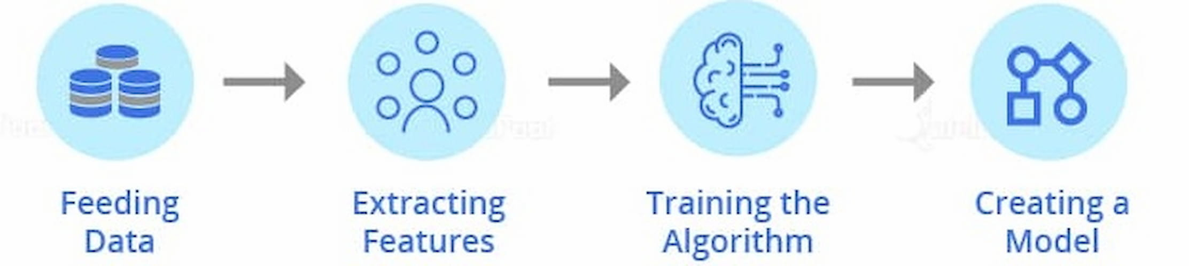



METHODOLOGY
An extensive review was done on existing works of literature and machine learning models on detecting phishing websites to best decide the classification models to solve the problem of detecting phishing websites.
Data Collection

Slide 13
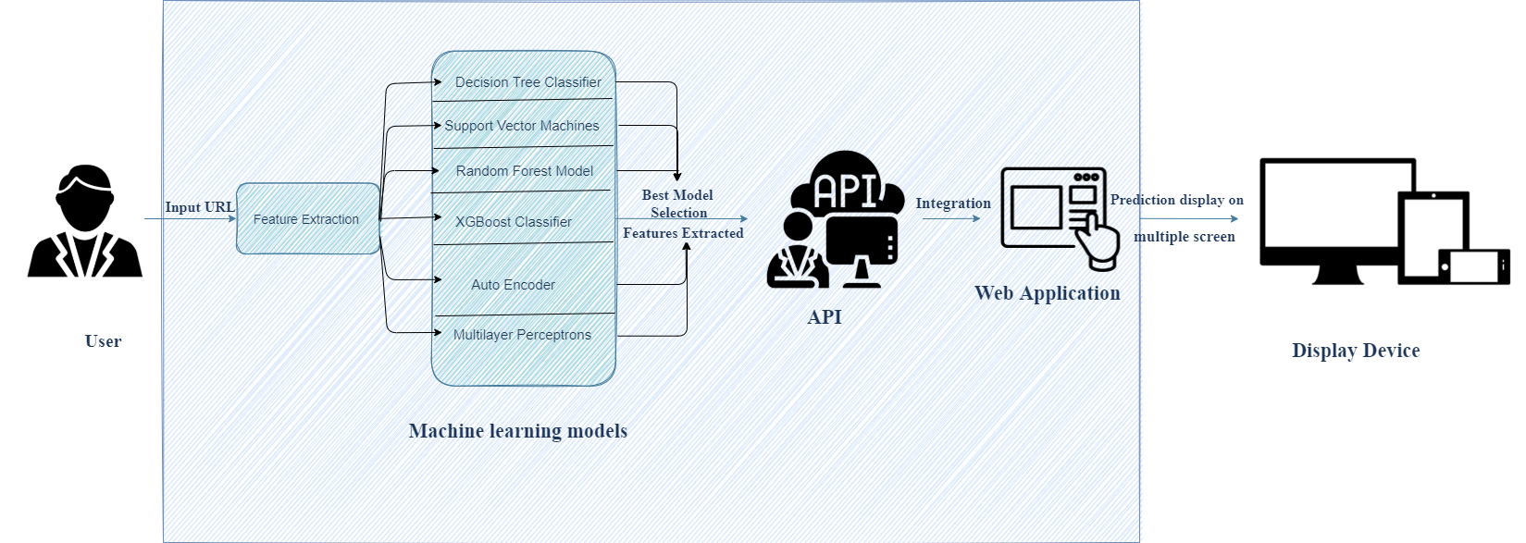
METHODOLOGY
Architectural design of proposed system zx

Slide 14
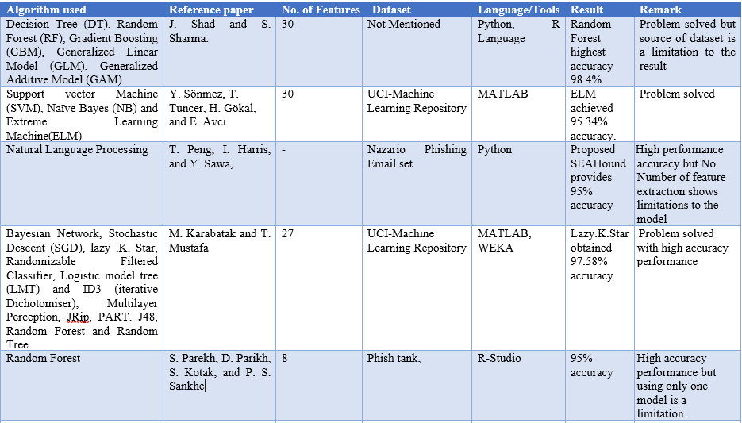
LITERATURE REVIEW

Slide 15
ANALYSIS OF EXISTING SYSTEM
The existing system of phishing detection techniques suffer low detection accuracy and high false alarm especially when different phishing approaches are introduced. Above and beyond, the most common technique used is the blacklist-based method which is inefficient in responding to emanating phishing attacks since registering new domain has become easier, no comprehensive blacklist can ensure a perfect up-to-date database for phishing detection.

Slide 16
ANALYSIS OF PROPOSED SYSTEM
The proposed phishing detection system utilizes different machine learning models and deep neural networks. The system comprises of two major parts, which are the machine learning models and a web application. These models consist of Decision Tree, Support Vector Machine, XGBooster, Multilayer Perceptions, Auto Encoder Neural Network and Random Forest.
These models are selected after different comparison based performance of multiple machine learning algorithms. Each of these models is trained and tested on a website content-based feature, extracted from both phishing and legitimate dataset.
Hence, the model with the highest accuracy is selected and integrated to a web application that will enable a user to predict if a URL link is phishing or legitimate

Slide 17

BENEFIT OF PROPOSED SYSTEM
Will be able to differentiate between phishing(0) and legitimate(1) URLs
Will help reduce phishing data breach for organization
Will be helpful to individuals and organizations
Will be easy to use
(Source: Credibly, n.d.)

Slide 18
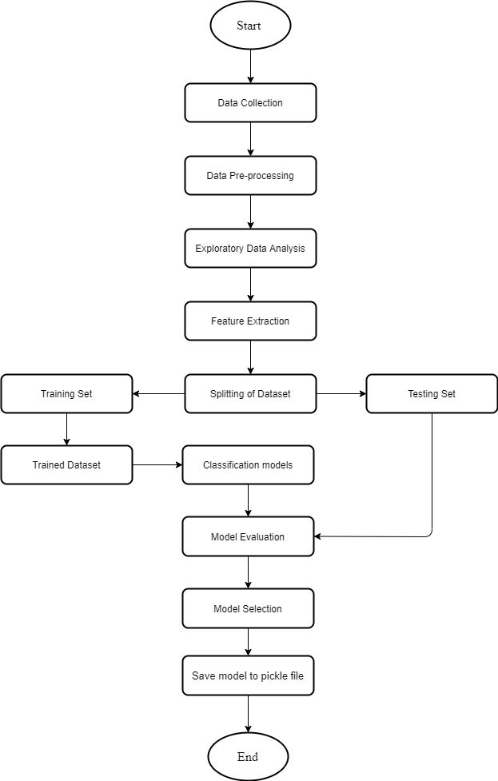
Machine Learning process

Slide 19
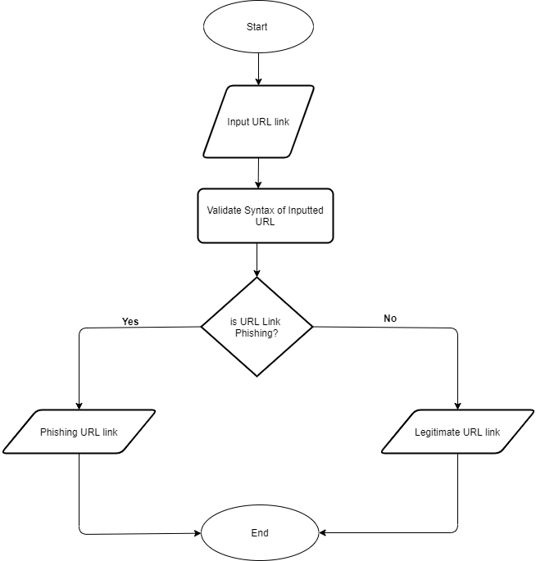
Flowchart of Web Application

Slide 20
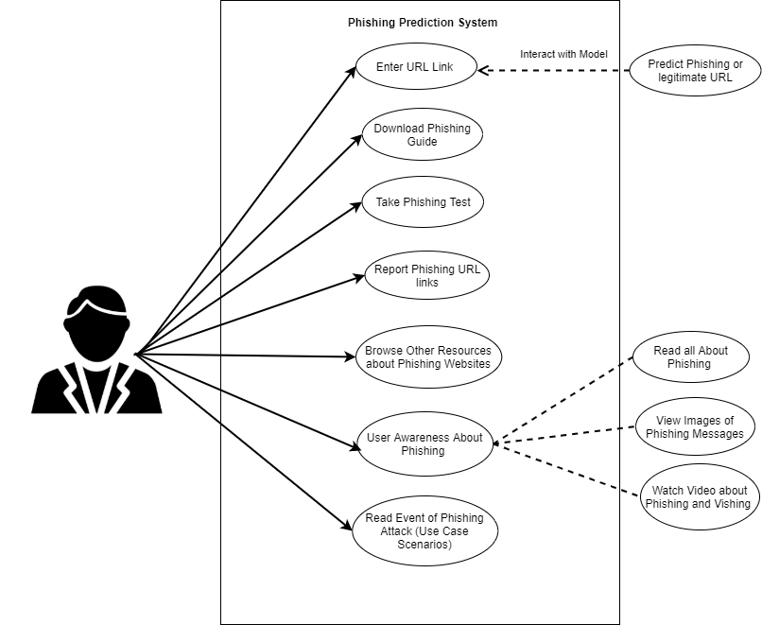
Use case of web Application

Slide 21
Implementation

Slide 22
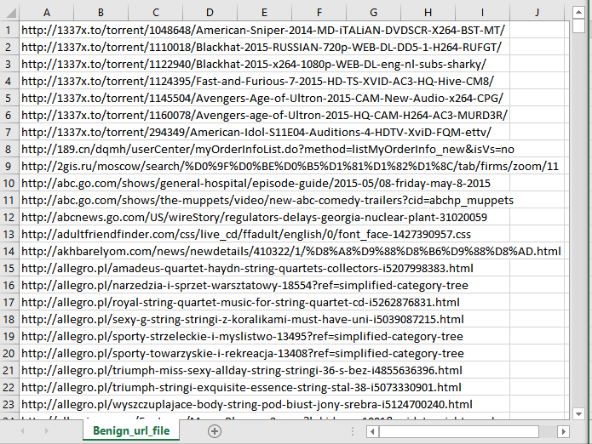
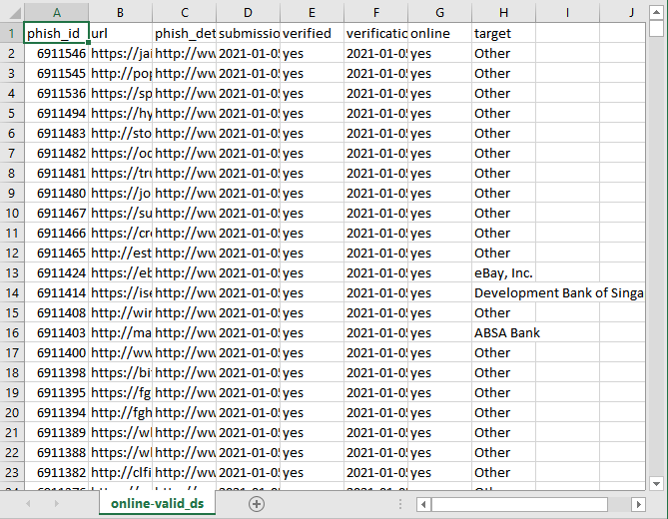
Data Collection
Dataset of Phishing URLs
Dataset of Legitimate URLs

Slide 23
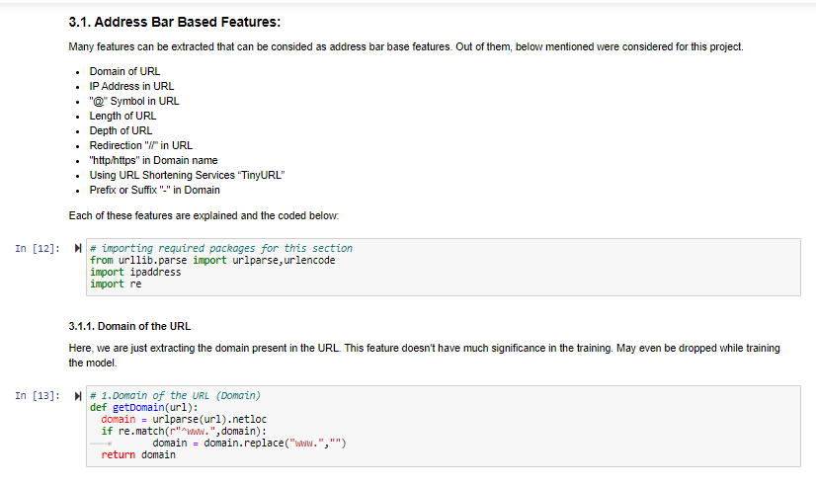

Slide 24
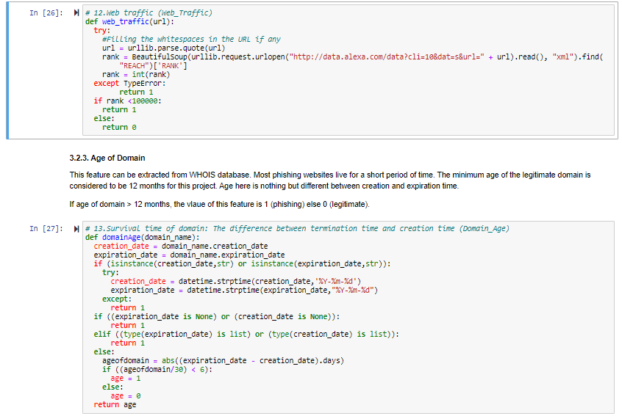

Slide 25
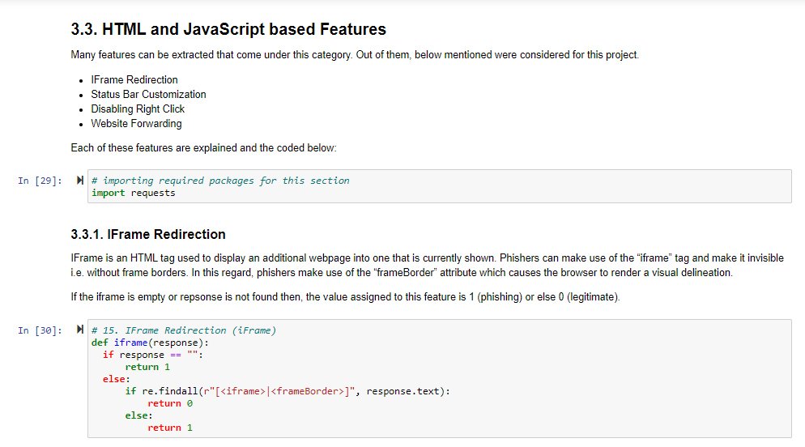

Slide 26
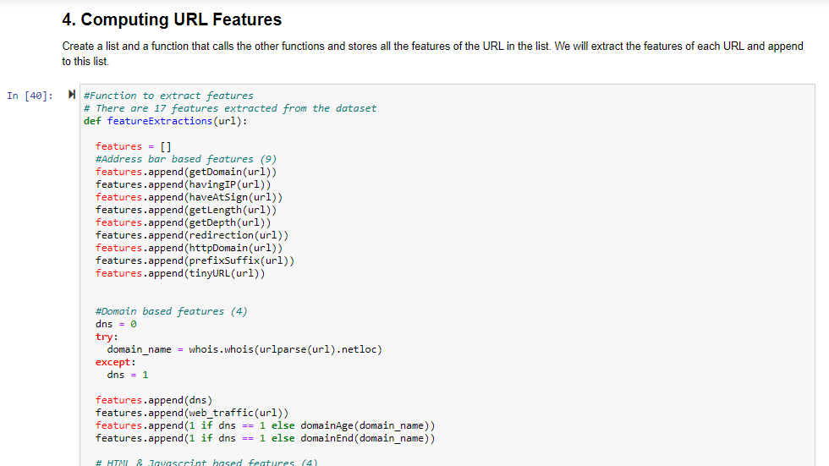

Slide 27
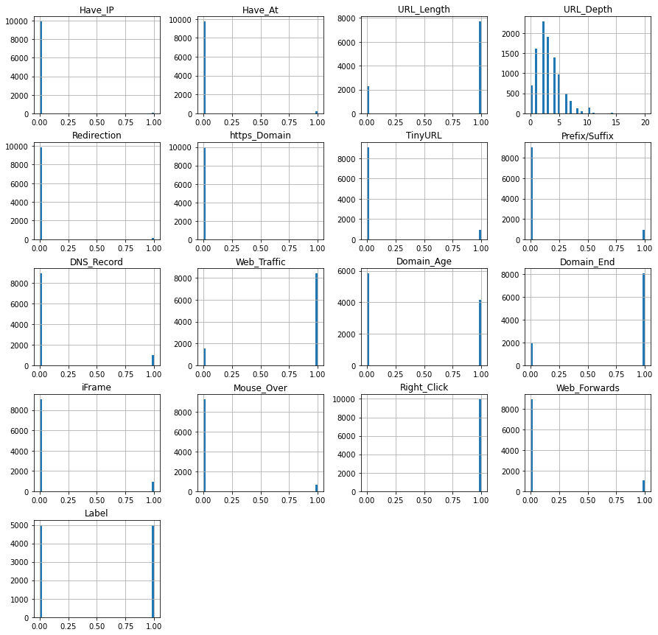

Slide 28
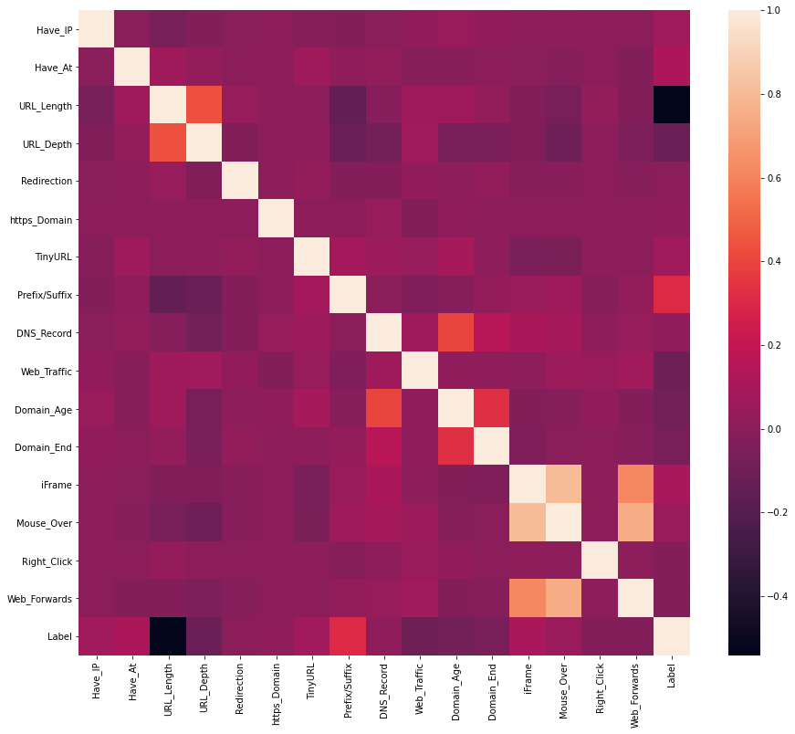

Slide 29
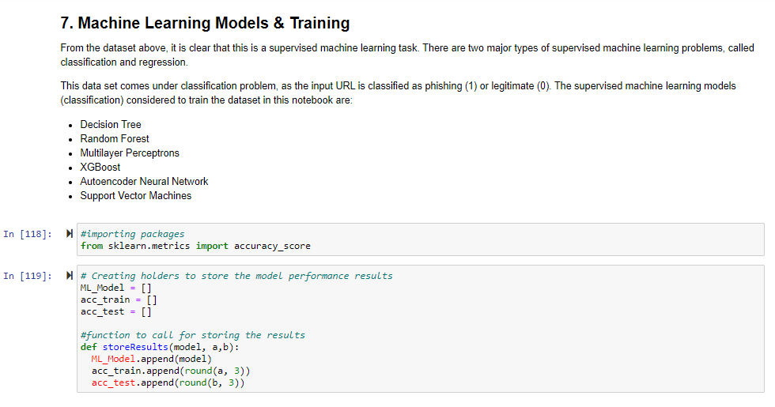

Slide 30
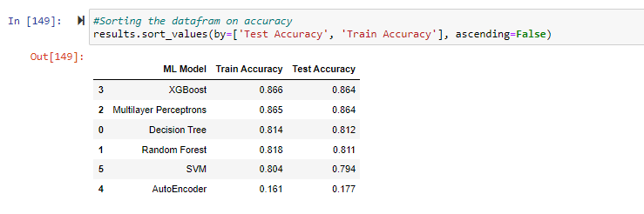

Slide 31
INTEGRATION OF MODEL TO WEB APPLICATION

Slide 32
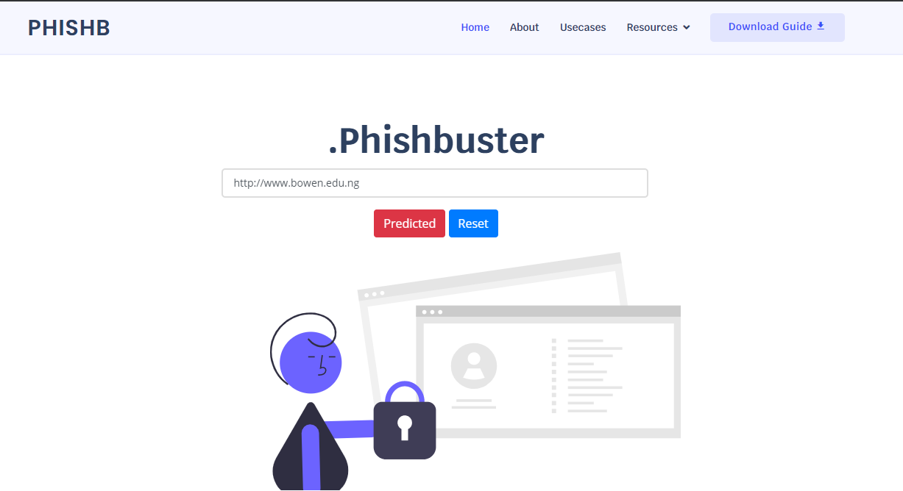

Slide 33
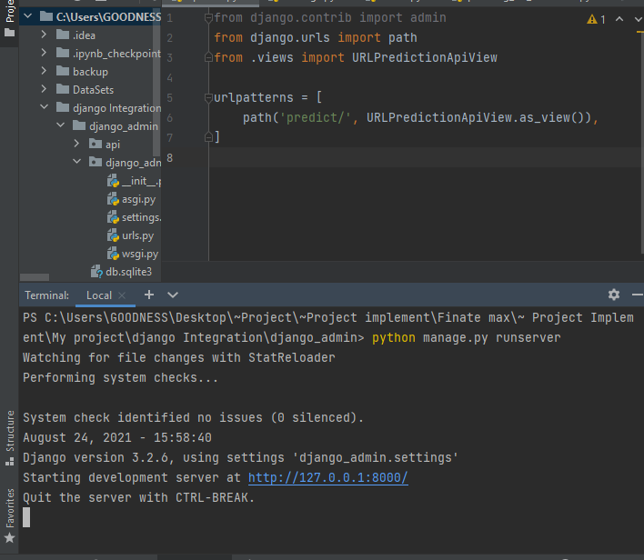

Slide 34
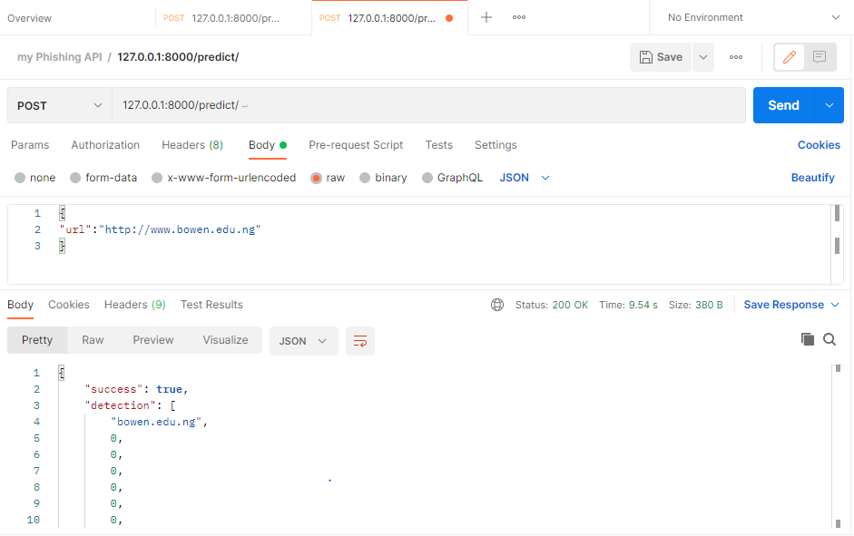

Slide 35
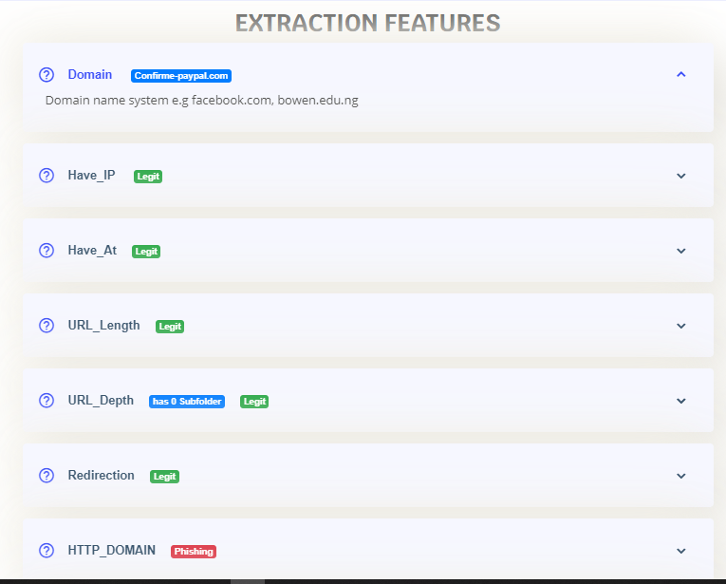

Slide 36
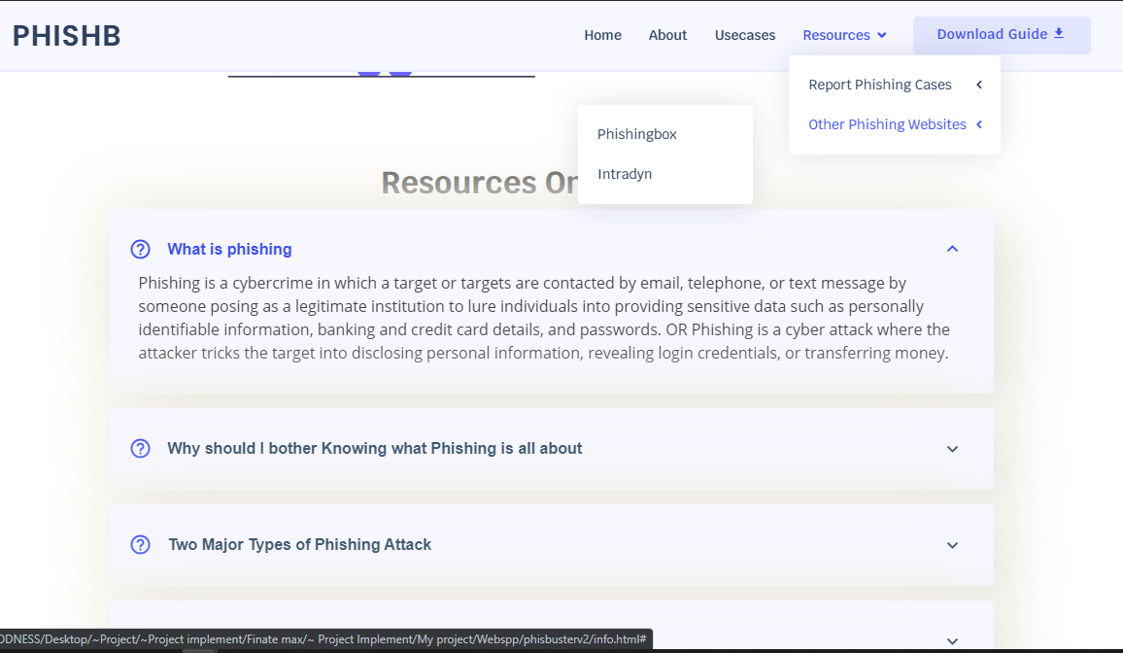

Slide 37
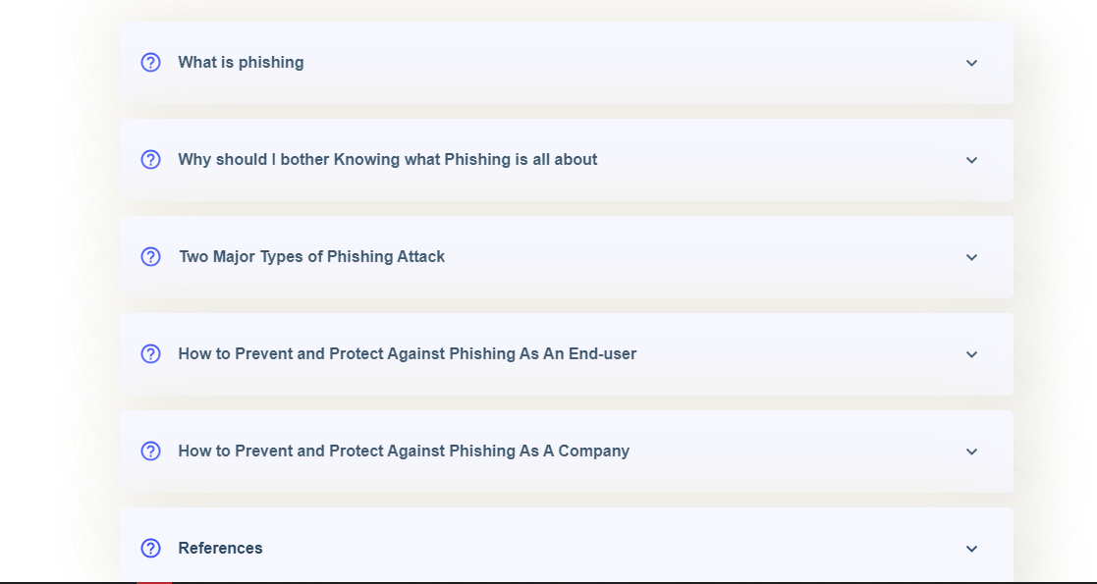

Slide 38

CONTRIBUTION TO KNOWLEDGE
This project provides an efficient and effective way for detecting phishing websites (URL) by exploring Data science classification technique.
This project tend to improve the previous technique for detecting phishing websites by employing different machine learning classification models and deep neural network to distinguish between phishing and legitimate URL links.
Hence, This project provides a new and faster way to help users detect if a URL link is phishing or legitimate and also provide them access to educational resources about phishing attacks.
(Source: Designed by Freepik, n.d.)

Slide 39

CONCLUSION
The contribution of this research work is to help both individuals and organization identify and understand phishing techniques used by phisher as well as help them detect phishing URL attack effectively and efficiently by employing machine learning models instead of the previous method of detecting phishing website.

Slide 40
Recommendation
Through this project, one can know a lot about phishing attacks and how to prevent them. This project can be taken further by creating a browser extension that can be installed on any web browser to detect phishing URL Links.

Slide 41
REFERENCES
Cyber attacker hacking into email server by Freepik. (n.d.). Retrieved from https://www.freepik.com/free-vector/cyber-attacker-hacking-into-email-server_5259895.htm#page=1&query=cyber%20phishing&position=2
People connecting jigsaw pieces of a head together by Freepik. (n.d.). Retrieved from https://www.freepik.com/free-vector/people-connecting-jigsaw-pieces-head-together_3425145.htm#page=1&query=knowledge&position=4
Group of people holding question mark icons by Freepik. (n.d.). Retrieved from https://www.freepik.com/free-vector/group-people-holding-question-mark-icons_3530048.htm#page=1&query=PROBLEM&position=12
Golden cup with arrow hitting in the target center by Freepik. (n.d.). Retrieved from https://www.freepik.com/free-vector/golden-cup-with-arrow-hitting-target-center_1311358.htm#page=1&query=AIM&position=25
Affective computing abstract concept illustration by Freepik. (n.d.).Retrieved from https://www.freepik.com/free-vector/affective-computing-abstract-concept-illustration_11668804.htm#page=1&query=machine%20learning&position=17

Slide 42

Thanks for listening till the end

